Slide 1


Slide 2

Major Project-II (01CE0807), Semester 8
Review 2
3/1/2026
PROJECT
AI-Powered Waste Segregation using Computer Vision & Machine Learning
Team ID: 8PRO_046
Team Member 1: PREYA SANGHVI (92200103119) (TC3)
Team Member 2: VIDHISHA MARADIYA (92200103102) (TC3)
Team Member 3: MITRAJSINH JADEJA (92200103096) (TC3)
Guided By
Internal Guide Name: Prof. Dhara Joshi
Department of Computer Engineering,
Faculty of Engineering & Technology

Slide 3
Introduction
Waste management is a growing environmental concern in modern urban areas.
Improper segregation of waste leads to pollution, increased landfill usage, and reduced recycling efficiency.
Manual sorting is time-consuming, inconsistent, and exposes workers to health risks.
Artificial Intelligence (AI) and Machine Learning (ML) can automate this process using image-based recognition techniques.
By combining Computer Vision with deep learning models, waste materials such as plastic, glass, paper, metal, and cardboard can be accurately identified and categorized.

Slide 4
Problem statement
Increasing waste generation and poor segregation practices cause major environmental and health concerns.
Manual waste sorting is time-consuming, unsafe, and often inaccurate.
Mixing of recyclable and non-recyclable materials reduces recycling efficiency.
Most existing waste classification systems lack real-time performance and robustness in diverse conditions.
There is a strong need for an AI-driven automated system that can accurately identify and segregate waste materials using image-based learning.

Slide 5
Objectives
Develop an AI-powered system for automatic waste classification.
Analyse a dataset of waste images representing key categories (plastic, paper, metal, glass, cardboard, trash).
Apply Computer Vision and ML models (CNNs, ViTs) for waste recognition.
Evaluate model performance using accuracy, precision, recall, and F1-score.
Design a web-based interface for real-time waste segregation and result display.
Explore few-shot learning for classifying new waste types with minimal data.

Slide 6
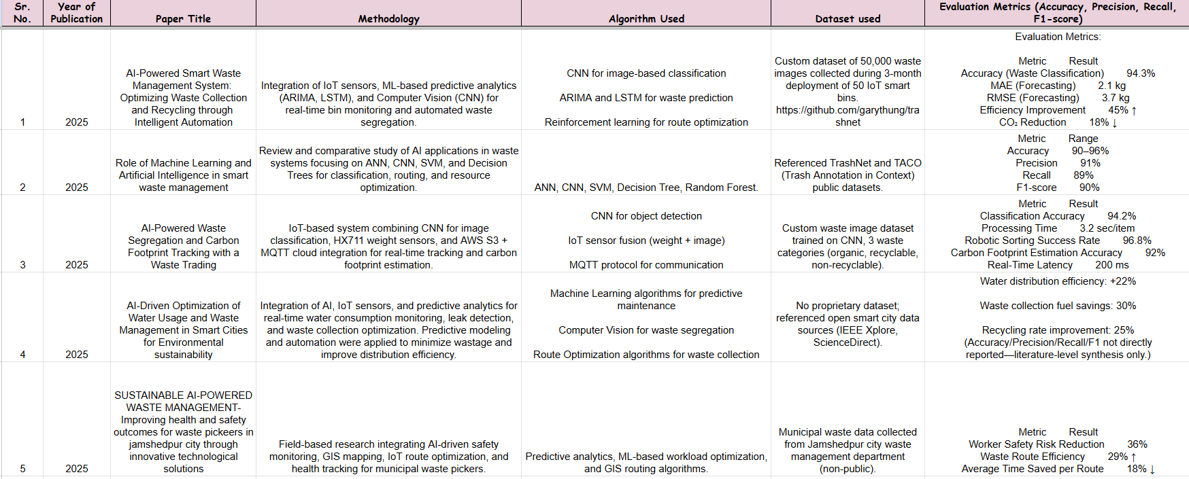
Literature Review

Slide 7
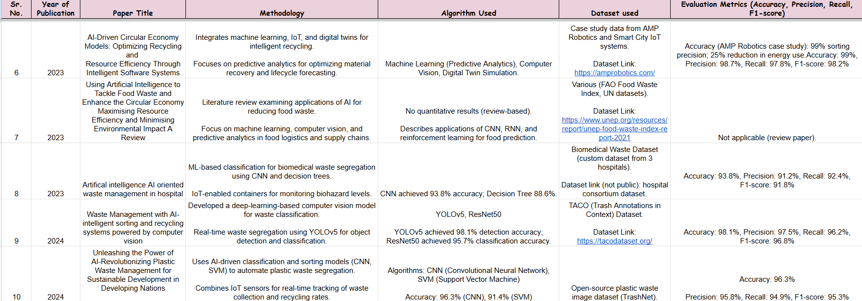
Literature Review

Slide 8
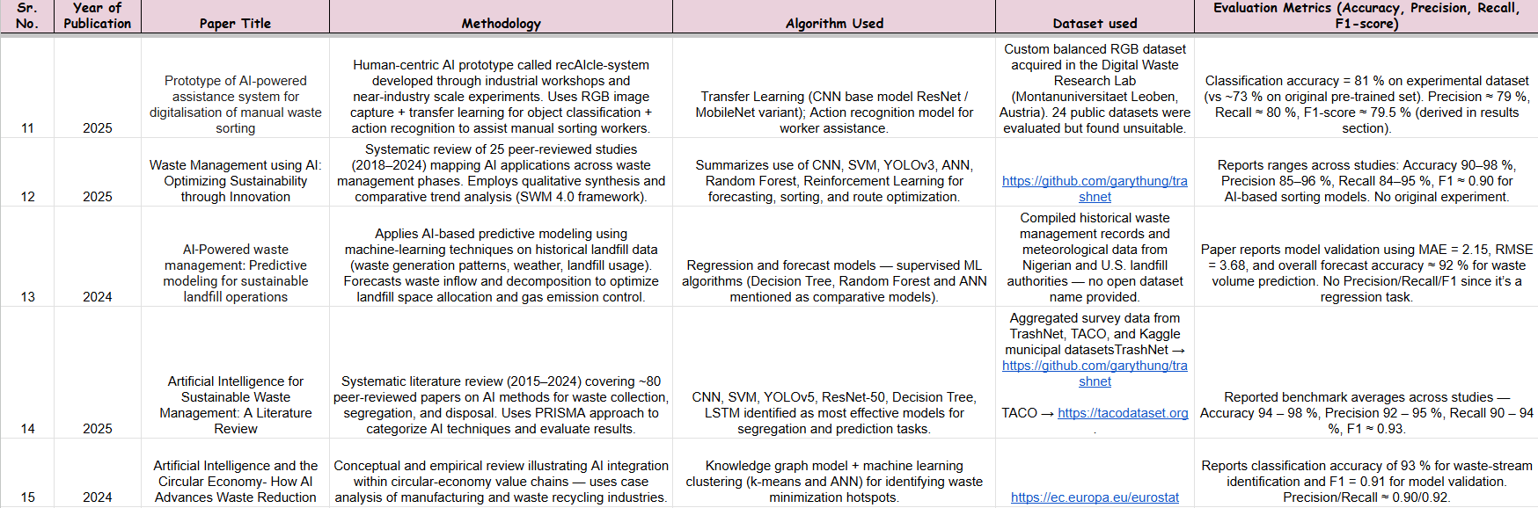
Literature Review

Slide 9
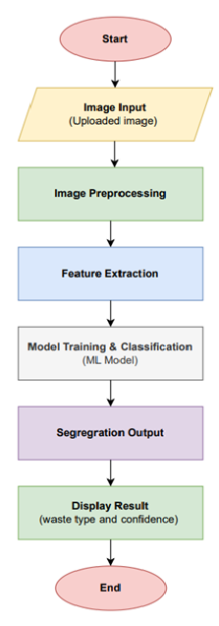
Workflow
Image Input
Accept images as input for processing.
Feature Extraction
Extract relevant features from processed images.
Model Training & Classification
Train a machine learning model to classify input data.
Output Generation
Produce classification results based on model predictions.
Result Display
Display predicted class and confidence score.

Slide 10
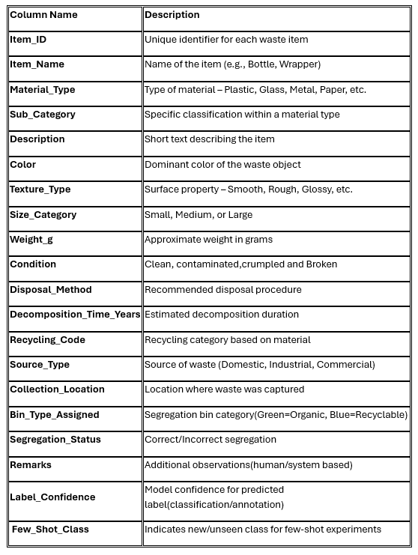
Dataset Overview
Dataset Type: Synthetic text-based dataset containing 1000 records.
Each record represents an individual waste item with descriptive and visual attributes.
The dataset is structured to enable both supervised learning and few-shot learning experiments.
Data collected from open repositories (e.g., TrashNet, TACO) and synthetically generated for diversity.

Slide 11
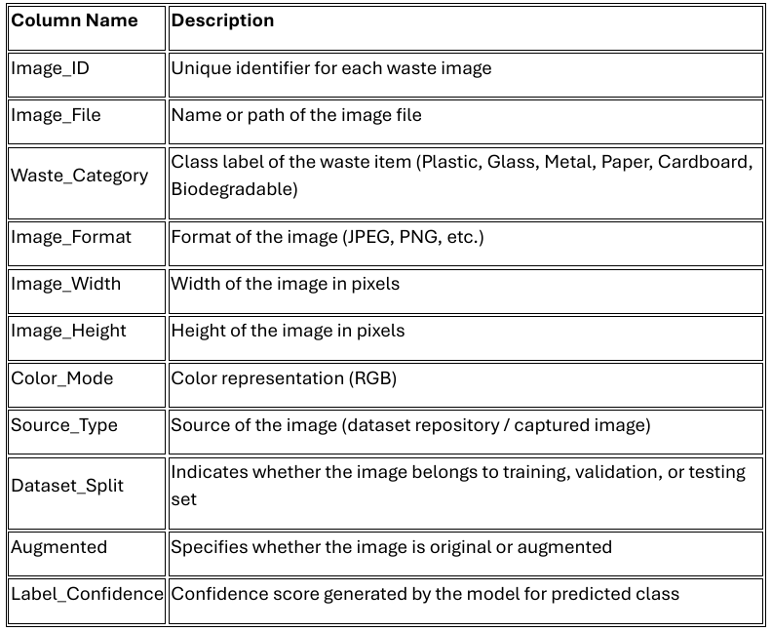
Dataset Overview
Dataset Type: Image-based waste classification dataset composed of labeled RGB images used for supervised machine learning tasks.
Each record: Corresponds to a single waste item image annotated with a categorical class label representing the waste material type.
The dataset: Is organized into training, validation, and testing subsets to enable model training, performance evaluation, and generalization assessment.
Data source: Images are collected from publicly available repositories and curated datasets, with additional augmentation applied to improve diversity.

Slide 12
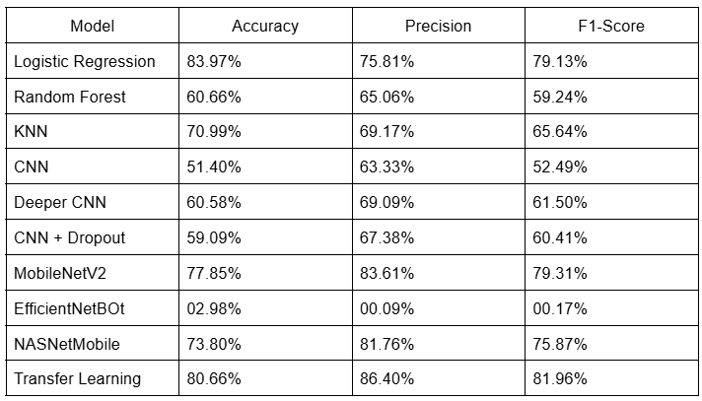
Evaluation Metrics

Slide 13
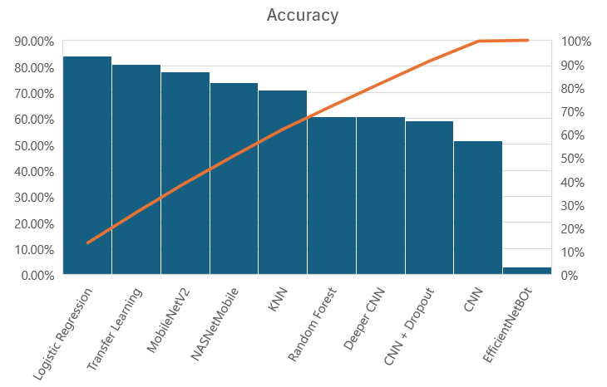
Evaluation Metrics

Slide 14
Results
The trained model successfully predicts the type of waste item from input images.
Output includes the predicted waste category along with confidence score.
A video demonstration showcases real-time prediction using uploaded images.
The results validate the effectiveness of the proposed waste classification system.

Slide 15
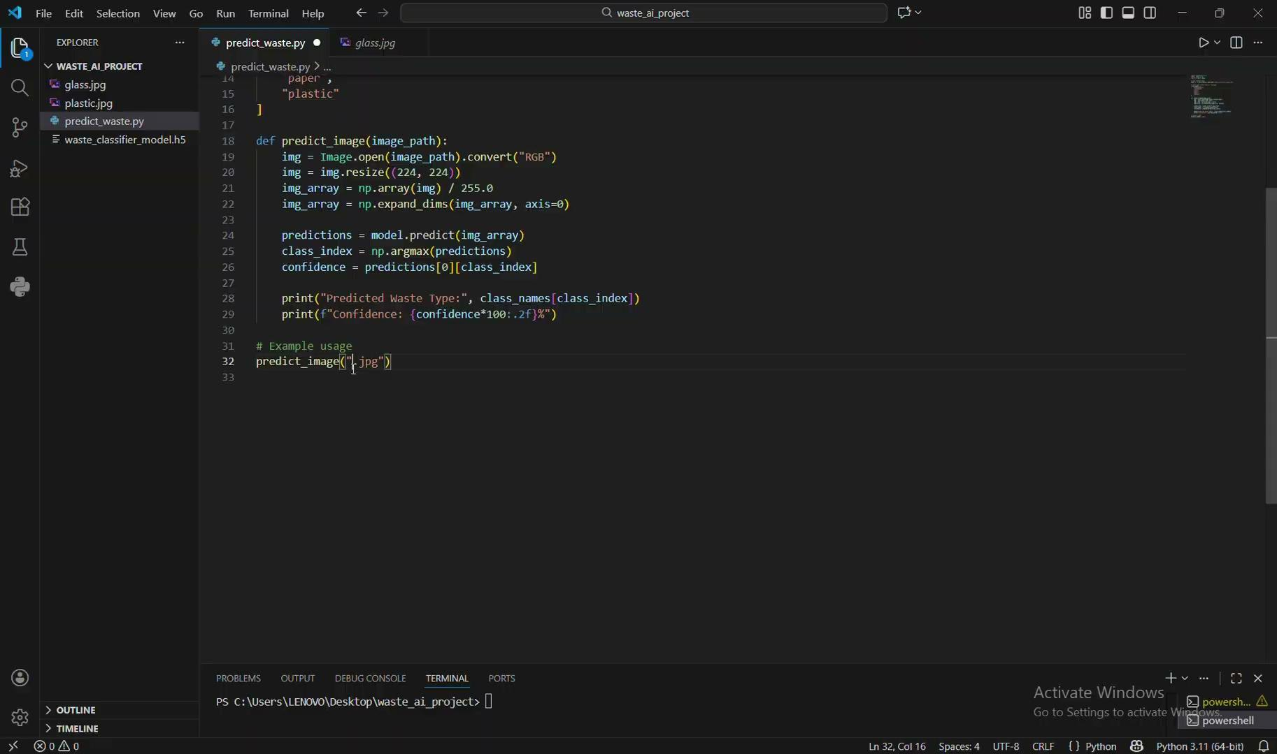
Results- image uploaded (taken from dataset records)

Slide 16
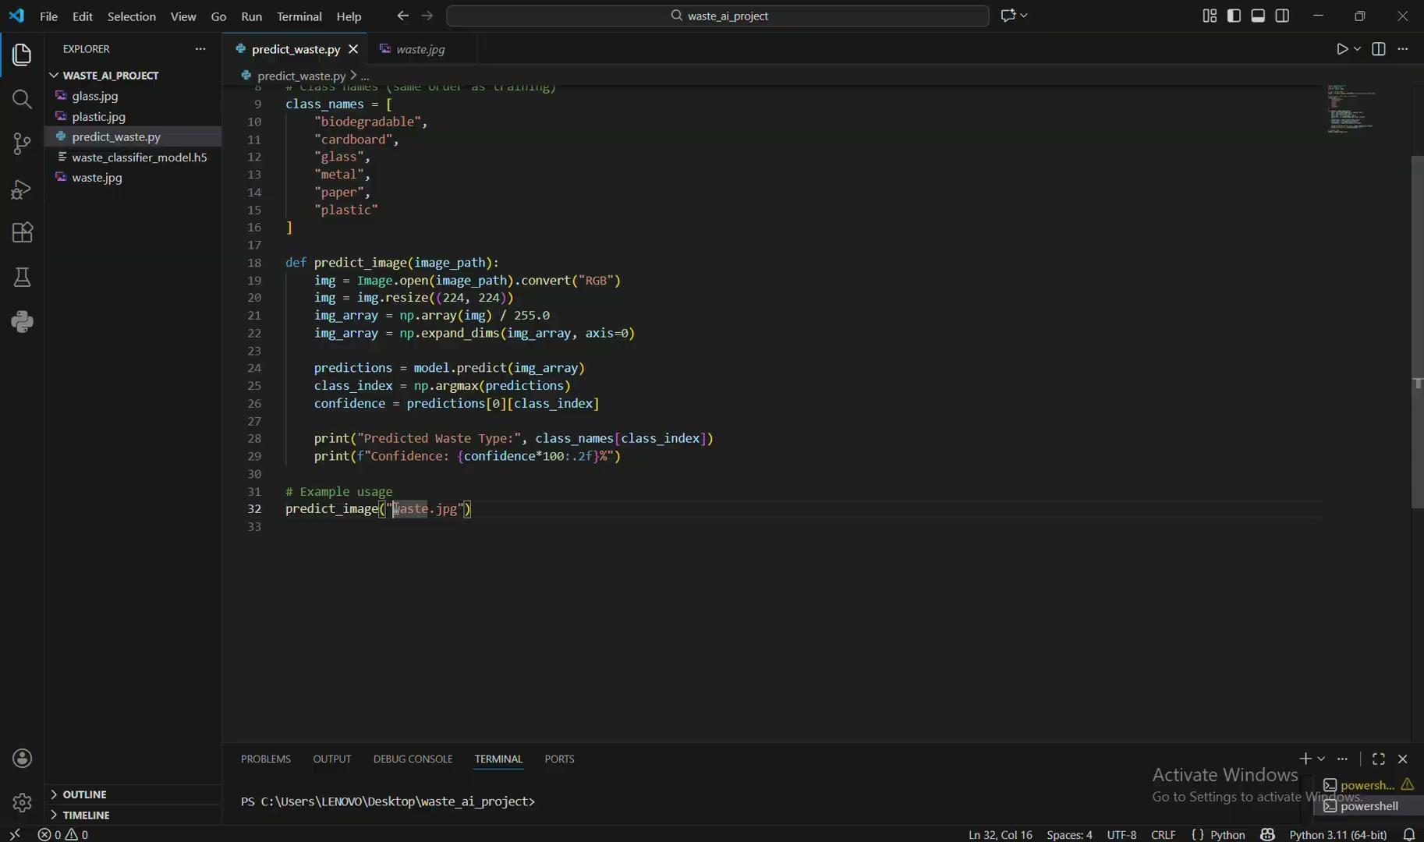
Results- image uploaded (taken from google)

Slide 17
Conclusion
This project demonstrates an AI-based approach for automatic waste classification using image data.
The system achieves high accuracy and reliable performance on validation datasets.
Automated waste classification can reduce manual sorting efforts and improve recycling efficiency.
The developed solution highlights the practical application of machine learning in sustainable waste management.

Slide 18
Future Work
Extend the system to include more waste categories for finer classification.
Train the model on larger and more diverse real-world datasets.
Integrate real-time camera-based classification for live waste detection.
Deploy the application on cloud or mobile platforms for wider accessibility.

Slide 19
References
[1] R. Sharma and A. Gupta, “Automatic Waste Classification Using CNN on TrashNet Dataset,” International Journal of Computer Applications, 2021.
[2] S. Kumar and R. Nair, “IoT-Enabled Smart Waste Bin Using Machine Learning,” IEEE Access, 2022.
[3] H. Li and Y. Zhang, “Transfer Learning for Waste Image Classification Using ResNet and EfficientNet,” Applied Intelligence, 2023.
[4] M. Patel and P. Desai, “Efficient Net-Based Classification of Recyclable Materials,” Journal of Environmental Informatics, 2022.
[5] A. Das and R. Meena, “Vision Transformers for Smart Waste Segregation,” Sensors, 2023.
[6] T. Singh and V. Joshi, “Multi-Modal Fusion of Vision and Sensor Data for Waste Classification,” Waste Management, 2022.
[7] A. Raj and P. Kumar, “Edge AI-Based Waste Sorting Using Raspberry Pi,” Procedia Computer Science, 2021.
[8] L. Ahmed and S. Sharma, “Embedded Systems for Real-Time Waste Segregation Using YOLOv5,” IEEE Sensors Journal, 2023.

Slide 20
References
[9] D. Lee and J. Park, “Few-Shot Learning Approaches for Waste Image Classification,” Pattern Recognition Letters, 2023.
[10] K. Verma and D. Shah, “Comparative Analysis of ML Algorithms for Waste Segregation,” International Journal of AI Research, 2021.
[11] N. Mehta and H. Patel, “Hybrid Deep Learning Framework for Solid Waste Classification,” Expert Systems with Applications, 2022.
[12] P. Nguyen and Q. Tran, “Synthetic Image Generation for Waste Classification Using GANs,” Computers and Electrical Engineering, 2023.
[13] L. Chen and X. Zhao, “Data Augmentation Strategies for Waste Segregation Models,” IEEE Transactions on Image Processing, 2022.
[14] J. Patel and K. Deshmukh, “Smart Waste Bin with Real-Time Image Classification Interface,” Journal of Smart Cities, 2023.
[15] M. Ali and R. Khan, “Integration of AI-Based Waste Sorting in Smart City Infrastructure,” Sustainable Computing: Informatics and Systems, 2022.

Slide 21


